Slide 1

GODADDY FIELD PROJECT:
COHORT ANALYSIS AND BUSINESS INSIGHTS
PRESENTATION
Women in Business
PRESENTED BY : VANSHIKA GUPTA

Slide 2

PROJECT OVERVIEW
Objective
Conduct cohort analysis of GoDaddy's business survey data to identify key market patterns and opportunities
Through EDA, identified women entrepreneurs as a critical focus area showing significant market shifts
Conduct a deep, data-driven cohort analysis of women entrepreneurs with focus on financial stressors
Analysis Methods:
Cohort analysis by demographic and non-demographic variables
CART analysis for persona development
Key Business Questions
What demographic and business patterns exist among women entrepreneurs?
What are the primary stressors for women entrepreneurs?
How do demographic factors intersect with entrepreneurial patterns?
What distinct entrepreneur personas exist among women business owners?
What strategic interventions could address the identified challenges?
PAGE 02

Slide 3
KEY INSIGHTS - BUSINESS TRENDS AND OPPORTUNITIES
BORCELLE
GENDER REPRESENTATION SHIFT
Women now outnumber men in newer businesses (2-3 years: 950 women vs. 644 men), yet remain significantly underrepresented in established ventures (10+ years: 971 women vs. 1,403 men).
FINANCIAL STRESS DOMINANCE
Nearly 30% of women entrepreneurs cite financial strain as their primary stressor, followed by work-life balance challenges as the second most significant issue.
WORK-HOUR PATTERNS
Most women entrepreneurs work just 1-10 hours weekly, with significant variations across racial groups and marital statuses, suggesting a predominance of side hustles or part-time ventures.
ENTREPRENEURIAL PERSONAS
Our analysis identified eight distinct segments - six financially stable (87%) and two financially stressed (13%) - with "The Full-Timer," "The Expert," "The Veteran," and "The Part-Timer" representing the majority.
PAGE 03

Slide 4
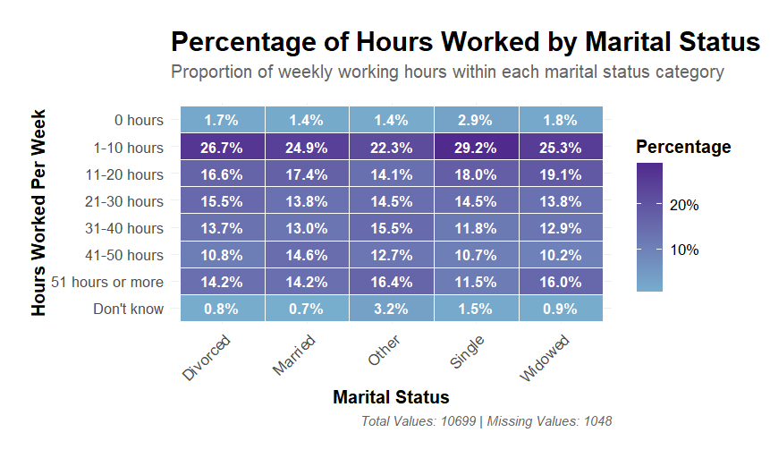
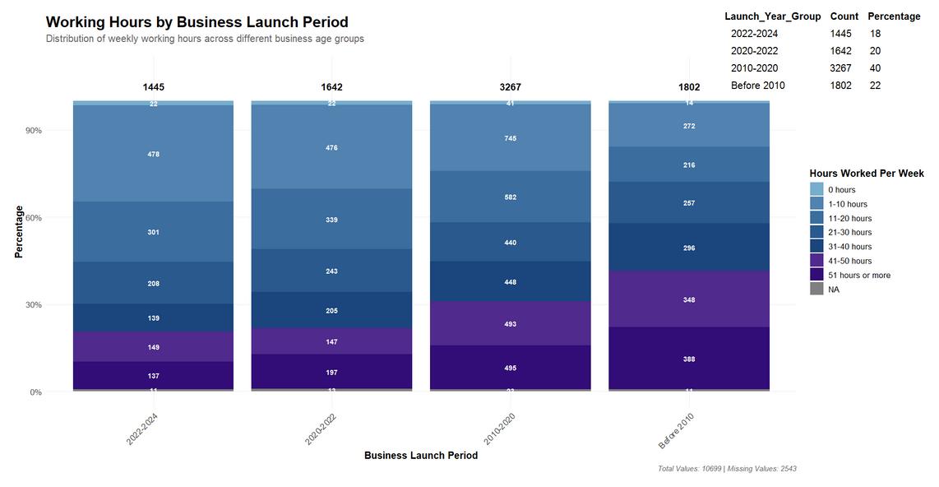
EXPLORATORY DATA ANALYSIS
Married individuals show a balanced work pattern, with significant shares in both part-time (1–10 hours: 24.9%) and (14%) long hours (51+ hours).
Single individuals are concentrated in low working hours, with 29% working only 1–10 hours and low (11.5%) working 51+ hours.
Widowed individuals work hours are mostly balanced, with 25.3% working 1–10 hours.
Newer businesses (2020–2024) show a higher concentration of working hours in the 1-10 and 10-20 hours range, as indicated by lighter shades.
Older businesses (pre-2020) exhibit a more balanced distribution across all hour categories, with a notable concentration in the 31-40 and 51+ hours range, as shown by darker shades.
PAGE 04

Slide 5
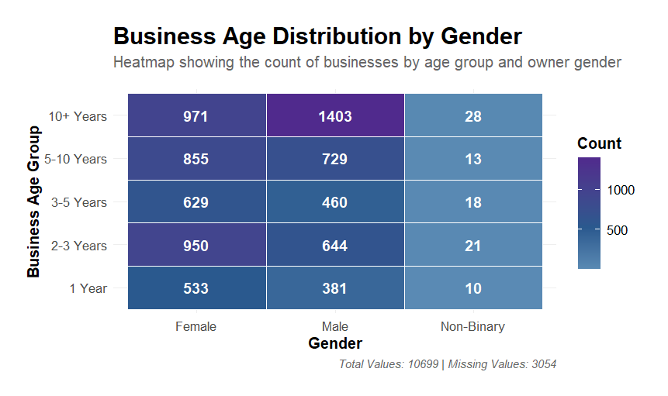
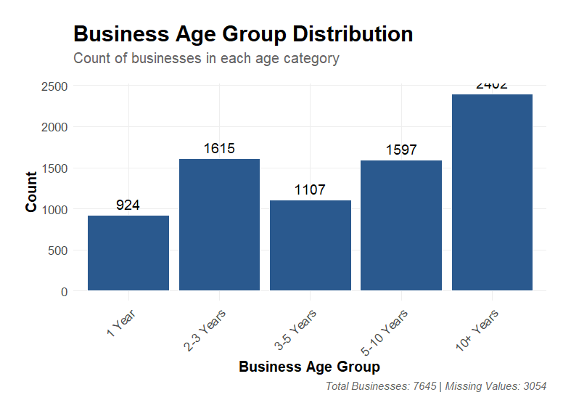
COHORT FORMATION:
WOMEN IN BUSINESS
Men Dominate Older Businesses: Male entrepreneurs lead in long-established businesses (10+ years).
Women Drive New Business Growth: Women outnumber men in the 1-3 year business categories, Overall suggesting the Gender Gap is Narrowing.
PAGE 05

Slide 6
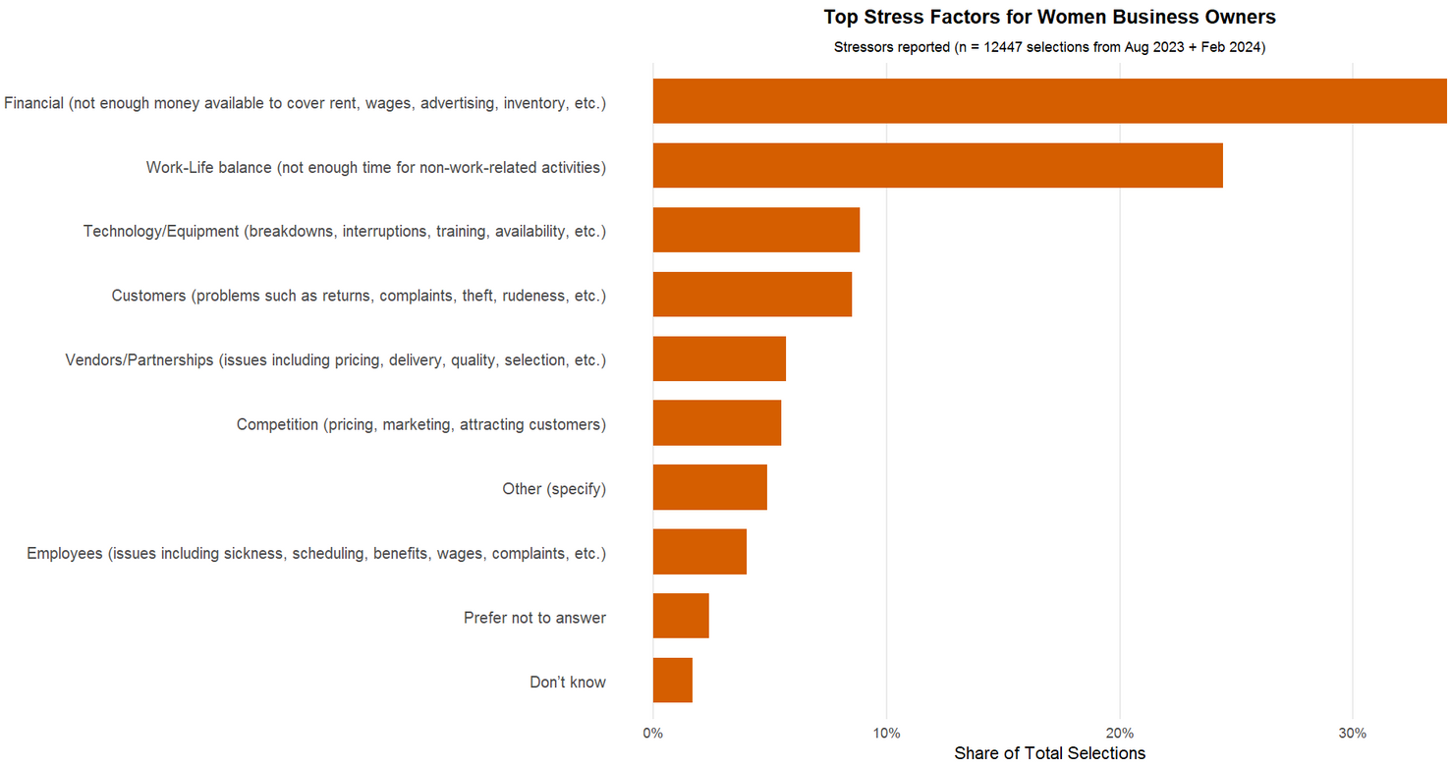
STRESS FACTORS AMONG FEMALE BUSINESS OWNERS
Stress factor responses specifically reported by women business
The top stressor by far is financial strain, cited in nearly 30% of all responses. This includes issues like covering rent, wages, and inventory areas pressing for early-stage businesses with limited capital reserves.
Work-life balance emerges as the second-largest challenge, reported by almost 25% of respondents. This highlights the dual burden many women face—juggling entrepreneurial duties with personal responsibilities.
Technology and customer problems were some other factors.
PAGE 06

Slide 7
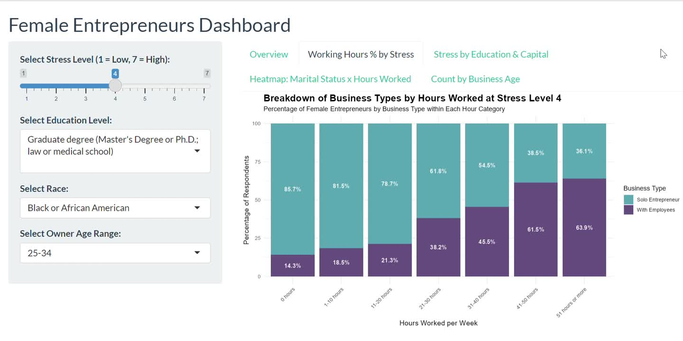
FROM SOLO TO TEAMWORK: STRESS PATTERNS IN WOMEN’S BUSINESSES
This bar chart shows how female entrepreneurs split between being solo and managing employees, based on how many hours they work per week and their stress level (1–7).
Most women are solo entrepreneurs at stress level 1.
At stress level 4, more women hire employees as work hours rise.
At stress level 7, most women working over 40 hours have employees, managing a team adds extra pressure.
To support them, things like leadership training, mentorship, and tips on delegation and work-life balance could go a long way in helping reduce stress without slowing their growth.
PAGE 07

Slide 8
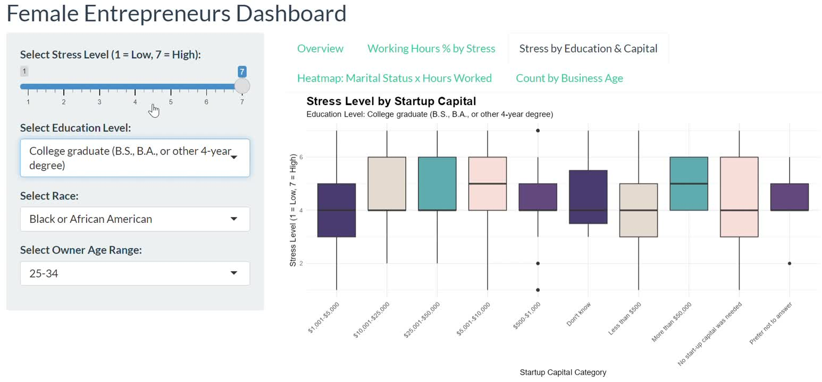
STRESS BY EDUCATION AND CAPITAL
The boxplot graph shows how startup capital levels relate to stress among female entrepreneurs, filtered by education level.
Among those with a graduate degree, stress levels are consistently moderate to high, especially for those who have capital $25,001–$50,000 or more than $50,000.
For high school graduates, stress levels are mostly moderate (3–5), but are notably higher for those who needed no startup capital or didn’t know their capital amount
Higher-educated women may be dealing with investor expectations, while lower-educated women might be navigating uncertainty or limited access to resources
PAGE 08

Slide 9
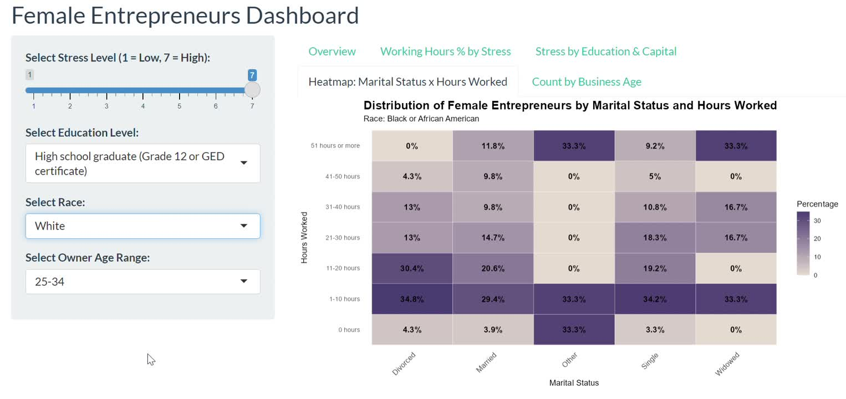
INFLUENCE OF RACE AND MARITAL STATUS ON WORKING HOURS OF FEMALE ENTREPRENEURS
This heatmap shows the distribution of weekly hours worked by female entrepreneurs across different marital statuses, and it updates based on the selected race category.
Among White female entrepreneurs, most work 1–10 or 21–30 hours weekly, but those who are widowed or report "Other" marital statuses tend to work 51+ hours, indicating a greater workload for these groups.
For Black or African American female entrepreneurs, the majority work 1–10 hours weekly across almost all marital statuses.
Women in more vulnerable marital categories — especially widows — tend to carry a heavier load, maybe because they have fewer financial or emotional support systems.
PAGE 09

Slide 10
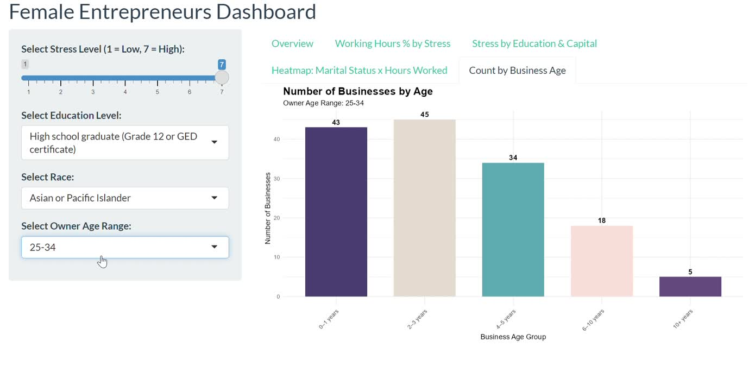
influence of Age on women’s entrepreneurial patterns
This graph displays the distribution of businesses by their age, segmented by the owner's age range.
The data shows that business longevity strongly correlates with the owner's age. Older owners (65+) primarily run long-established businesses, highlighting experience and long-term survival.
Owners aged 45–54 display a balanced presence across both newer and older businesses.
Younger owners (25–34) run businesses less than 5 years old, indicating a strong trend toward recent entrepreneurial activity with limited long-term establishment.
PAGE 10

Slide 11
PERSONAS
Who Are the Women Entrepreneurs Shaping the Future?
Financially Stable (87%)
Six personas demonstrating resilience despite variations in business size, work hours, and startup resources.
➔ They effectively manage stress and maintain financial health, showing strong potential for long-term growth, mentorship, or scaling support.
Financially Stressed (13%)
Two personas facing high vulnerability due to limited education, minimal capital, and structural business challenges.
➔ They are at greater risk of financial instability and business failure without targeted intervention and support programs.
PAGE 11

Slide 12
WOMEN IN BUSINESS
OUR RECOMMENDATIONS
Financial Empowerment
Digital Optimization
Tiered pricing for entry packages
Partner with micro-lenders
AI cash flow tools
Growth milestone discounts
• Simplified website builders
• SEO toolkits
• Mobile-first commerce solutions
• Adaptive content calendars
Operational Efficiency
Community & Mentorship
Personalized Growth
• One-click task automation
• Stress-sensitive dashboards
• Service pause options
• Smart scheduling tools
• Women’s forum on platform
• Mentorship matching program
• Virtual industry roundtables
• Success story knowledge base
• Business diagnostic tools
• Simplified market analysis
• Customized learning paths
• Virtual office hours with experts
PAGE 12
Notes:
To support women entrepreneurs, we recommend simplifying digital tools, automating routine tasks, and using AI to ease operational stress. Personalized growth paths, diagnostics, and virtual expert hours can guide their journey. Creating community spaces like forums, mentorship programs, and success story hubs will foster shared learning and confidence. Finally, smart pricing models and access to funding partners can ease financial pressure and unlock sustainable growth.

Slide 13
CONCLUSION AND PATH FORWARD
Key Insights
• Women entrepreneurs face unique financial stress patterns
• Business age and work hours impact stress and sustainability
• 4 personas represent over 50% of women-led businesses
• Gender gap reverses , women underrepresented in mature ventures
Strategic Implications
• Need targeted, stage-specific support, not one-size-fits-all
• Simplified tools for scaling older businesses
Path Forward
• Reduce financial stress through smart pricing
• Boost resilience with growth-stage tools
• Enable more women-led businesses to cross 10+ years
PAGE 13

Slide 14


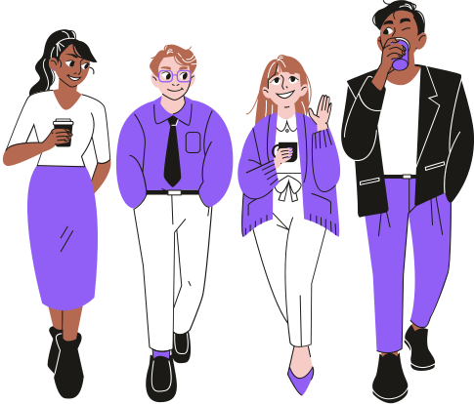
THANK YOU FOR YOUR ATTENTION!
Any questions?

